Slide 1
Custom Metrics for a Python Based Application as Knative Service and Metrics Storage and Aggregation
Story#291

Slide 2
Story#291 Custom Metrics for a Python based Application
Developed a Python Web Application, which is of login page if we provide valid login credentials it will display login successful else if will display login failed.
Added hooks source code to Store the Metrics like, Total number of login requests, Successful requests and Failed Request, source code is
Login page template file is ->
Containerised the Application to image “tvkrishna21/python-login-app-with-exp:1.1.3”
Developed Mysql Image with Database and Tables needed to store the Custom metrics, image -> “tvkrishna21/mysql-custmetrics:1.0.0” , source code is
Created Prometheus and Grafana to Scrape the metrics from the Application end point to Visualize the metrics.
Created Custom Dashboard Panels in Grafana, Dashboard panels json file ->

Slide 3
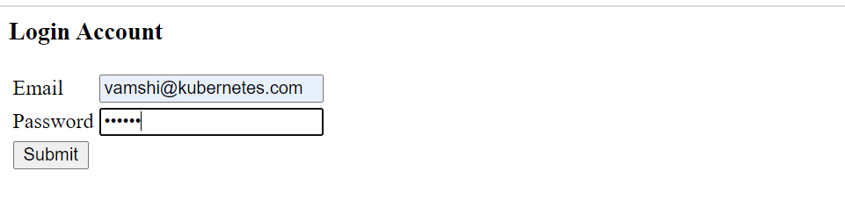
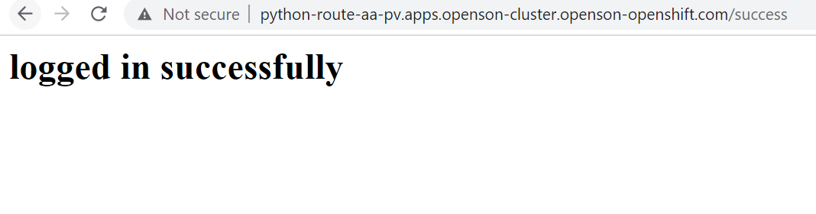
Login Page, Valid Credentials are Email is vamshi@kubernetes.com and password is vamshi.
For Valid credentials, it will display the below message.

Slide 4
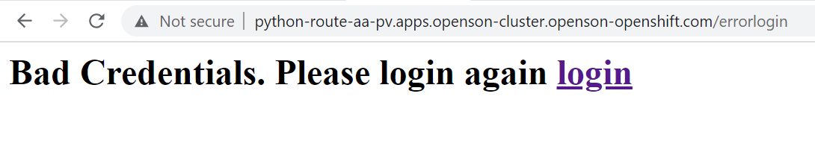
For Invalid Credentials, it will display the below message.

Slide 5
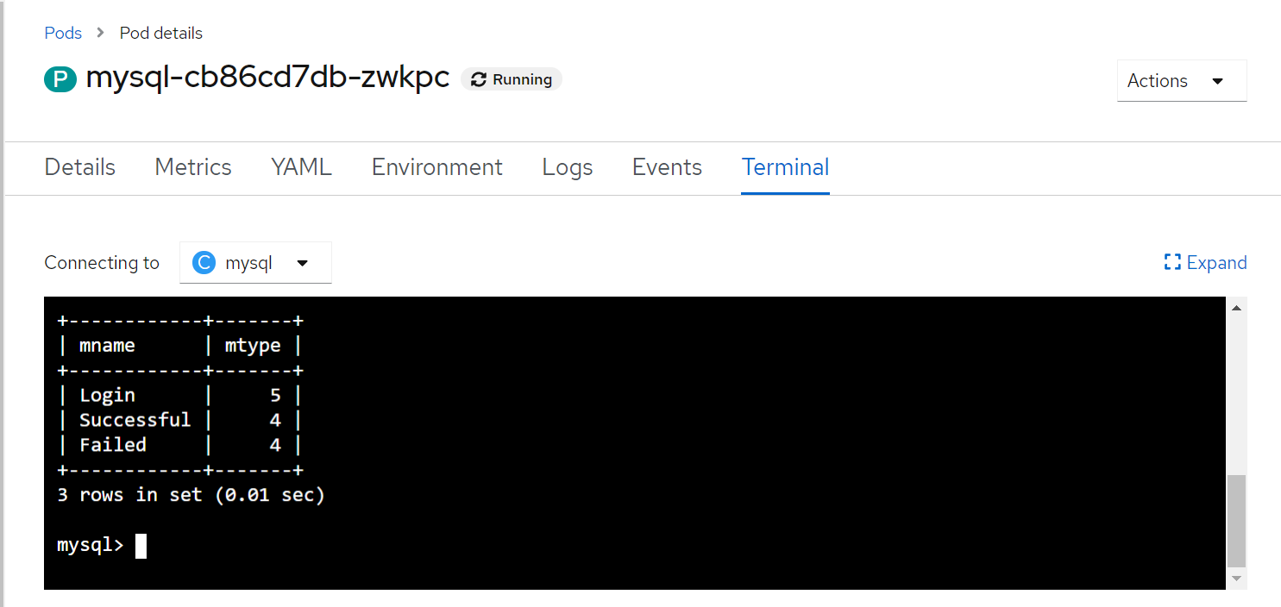
Mysql Terminal view of Metrics population

Slide 6
Created PV and PVC for Database Persistence, yaml files ->
Python Application deployment as Knative Service yaml ->
Mysql DB deployment yaml ->

Slide 7
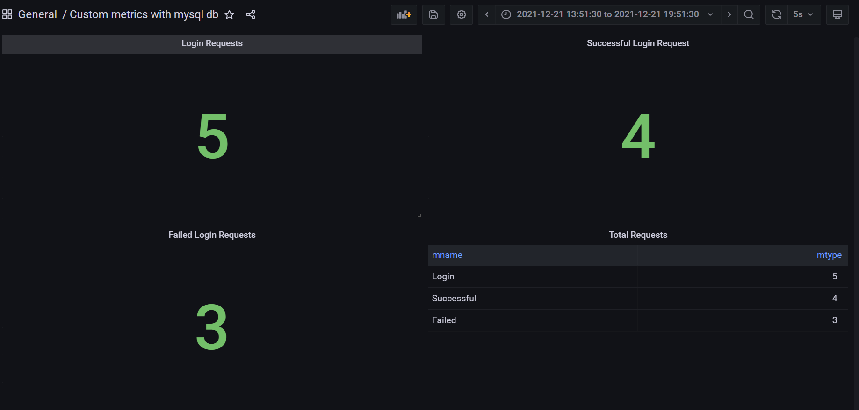
Grafana Dashboards Application Specific

